Slide 1
Today’s Material
Sorting
  Definitions
Basic Sorting Algorithms
  BubleSort
  SelectionSort
  InsertionSort
Divide & Conquer (Recursive) Sorting Algorithms
  MergeSort
  QuickSort

Slide 2
Recursive Sorting Algorithms
What about a divide & conquer strategy?
Merge Sort
  Divide the array into two halves
  Sort the left half
  Sort the right half
  Merge the sorted halves to obtain the final sorted array
Quick Sort
  Uses a different strategy to partition the array into two halves

Slide 3
MergeSort Example
0
1
2
3
4
5
6
7
8
2
9
4
5
3
1
6
Divide
Divide
8 2 9 4
5 3 1 6
8 2
9 4
5 3
1 6
Divide
1 element
8
2
9
4
5
3
1
6
Merge
2 8
4 9
3 5
1 6
Merge
2 4 8 9
1 3 5 6
Merge
Sorted Array
1 2 3 4 5 6 8 9

Slide 4
MergeSort
MergeSort – A[1..N]
Stopping rule:
    If N == 1 then done
Key Step
  Divide:
    Consider the smaller arrays A[1..N/2], A[N/2+1..N]
  Conquer:
    M1 = Sort (A[1..N/2])
    M2 = Sort (A[N/2+1..N]
  Merge:
    Merge(M1, M2) to produce the sorted array A

Slide 5

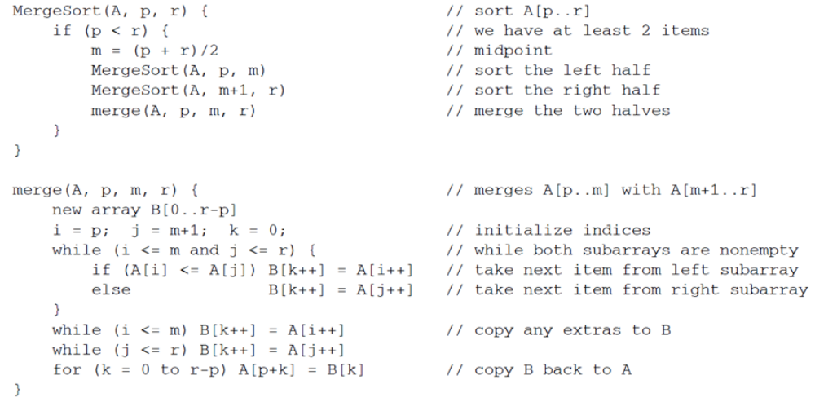
MergeSort PseudoCode

Slide 6
Recursive Calls of MergeSort
N
N/2
N/4
N/8
T(n) = 2*T(n/2) + N
Time to sort the 2 subarray
Time to merge the 2 sorted subarray

Slide 7
Divide and Conquer Without Extra Space?
Mergesort requires temporary array for merging = O(N) extra space
  Can we do in place sorting without extra space?
  Want a divide and conquer strategy that does not use the O(N) extra space
Quicksort – Idea:
  Partition the array such that Elements in left sub-array < elements in right sub-array.
  Recursively sort left and right sub-arrays

Slide 8
How do we Partition the Array?
Choose an element from the array as the pivot
Move all elements < pivot into left sub-array and all elements > pivot into right sub-array
E.g.,
    7 18 2 15 9 11
    Suppose pivot = 7
    Left subarray = 2
    Right sub-array = 18 15 9 11

Slide 9
Quicksort
Quicksort Algorithm:
  Partition array into left and right sub-arrays such that: Elements in left sub-array < elements in right sub-array
  Recursively sort left and right sub-arrays
  Concatenate left and right sub-arrays with pivot in middle
How to Partition the Array:
  Choose an element from the array as the pivot
  Move all elements < pivot into left sub-array and all elements > pivot into right sub-array
Pivot?
  One choice: use first element in array

Slide 10
Quicksort Example
Sort the array containing:
9
16
4
15
2
5
17
1
Pivot
Partition
4 2 5 1 <
9
< 16 15 17
Partition
2 1
4
5
15
16
17
Concatenate
1
2
5
15
17
1 2
4
5
15 16 17
Concatenate
Concatenate
1 2 4 5 9 15 16 17

Slide 11
Partitioning In Place
Seems like we need an extra array for partitioning and concatenating left/right sub-arrays
  No!
Algorithm for In Place Partitioning:
  pivot=A[0]
  Set pointers i and j to the beginning and the end of the array
  Increment i until you hit an element A[i] > pivot
  Decrement j until you hit an element A[j] < pivot
  Swap A[i] and A[j]
  Repeat until i and j cross (i exceeds or equals j)
  Restore the pivot by swapping A[0] with A[j]
Example: Partition in place:
  9 16 4 15 2 5 17 1 (pivot = A[0] = 9)

Slide 12
Partitioning In Place
Swap
1
9 16 4 15 2 5 17 1
Swap A[i] and A[j]
16
i
j
Swap
5
15
Swap A[i] and A[j]
9 1 4 15 2 5 17 16
i
i
j
j
Swap
9 1 4 5 2 15 17 16
Swap A[j] and pivot]
2
9
j
i
i
Partitioning Complete
2 1 4 5 9 15 17 16
<=9
>=9

Slide 13
Partition Algorithm
int Partition(int A[], int N){
if (N<=1) return 0;
int pivot = A[0]; // Pivot is the first element
int i=1, j=N-1;
while (1){
while (A[j]>pivot) j--; // Move j
while (A[i]<pivot && i<j) i++; // Move i
if (i>=j) break;
Swap(&A[i], &A[j]);
i++; j--;
} //end-while
Swap(&A[j], &A[0]); // Restore the pivot
return j; // return the index of the pivot
} //end-Partition

Slide 14
Pivotal Role of Pivots
How do we pick the pivot for each partition?
  Pivot choice can make a big difference in run time
1st Idea: Pick the first element in (sub)array as pivot
  What if it is the smallest or largest?
  What if the array is sorted? How many recursive calls does quicksort make?
2 4 6 8 9
2 4 6 8 9
2 4 6 8 9
2 4 6 8 9
2 4 6 8 9
Total: O(N) recursive calls!

Slide 15
Choosing the Right Pivot
2nd Idea: Pick a random element
  Gets rid of asymmetry in left/right sizes
  But…requires calls to pseudo-random number generator – expensive/error prone
3rd idea: Pick median (N/2 largest element)
Ideal but hard to compute without sorting!
Compromise: Pick median of three elements
9 16 4 15 2
9 4 2 15 16

Slide 16
Median-of-Three Pivots
Find the median of the first, middle and last element
2 4 9 15 16
5 4 2 15 16
9
5
Takes only O(1) time and not error-prone like the pseudorandom pivot choice
Less chance of poor performance as compared to looking at only 1 element
For sorted inputs, splits array nicely in half each recursion
  Good performance

Slide 17
Partition with MedianOf3 Heuristic
42
71
10
14
95
63
38
27
81
56
Before Partition
Pivot = MedianOf3(42, 95, 56) = 56
42
71
10
14
81
63
38
27
56
95
After MedianOf3
i
j
42
27
71
71
10
14
81
63
38
27
56
95
Need to swap 71 & 27
i
j
42
27
10
14
38
81
81
63
38
71
56
95
Need to swap 81 & 38
i
j
42
27
10
14
38
56
63
63
81
71
56
95
Swap A[i]=63 & pivot=56
j
i
42
27
10
14
38
56
81
71
63
95
After Partition
<= 56
>= 56

Slide 18
MedianOf3 Algorithm
// Assumes N>=3
int MedianOf3(int A[], int N){
int left = 0;
int right = N-1;
int center = (left+right)/2;
// Sort A[left], A[right], A[center]
if (A[left] > A[center]) Swap(&A[left], &A[center]);
if (A[left] > A[right]) Swap(&A[left], &A[right]);
if (A[center] > A[right]) Swap(&A[center], &A[right]);
Swap(&A[center], &A[right-1]); // Hide the pivot
return A[right-1]; // Return the pivot
} //end-MedianOf3

Slide 19
Partition with MedianOf3
// Assumes N>=3
int Partition(int A[], int N){
int pivot = Median3(A, 0, N-1);
int i = 0; int j = N-1;
while (1){
while (A[++i] < pivot);
while (A[--j] > pivot);
if (i < j) Swap(&A[i], &A[j]);
else break;
} //end-while
Swap(&A[i], &A[N-2]); // Restore the pivot
return i;
} //end-Partition

Slide 20
QuickSort Performance Analysis
Best Case Performance: Algorithm always chooses best pivot and keeps splitting sub-arrays in half at each recursion
  T(0) = T(1) = O(1) (constant time if 0 or 1 element)
  For N > 1, 2 recursive calls + linear time for partitioning
  Recurrence Relation for T(N) = 2T(N/2) + O(N)
  Big-Oh function for T(N) = O(N logN)

Slide 21
QuickSort Performance Analysis
Worst Case Performance: Algorithm keeps picking the worst pivot – one sub-array empty at each recursion
  T(0) = T(1) = O(1)
  T(N) = T(N-1) + O(N)
  T(N-2) + O(N-1) + O(N) = …
  T(0) + O(1) + … + O(N)
  T(N) = O(N² )
Fortunately, average case performance is O(N log N)

